Slide 1
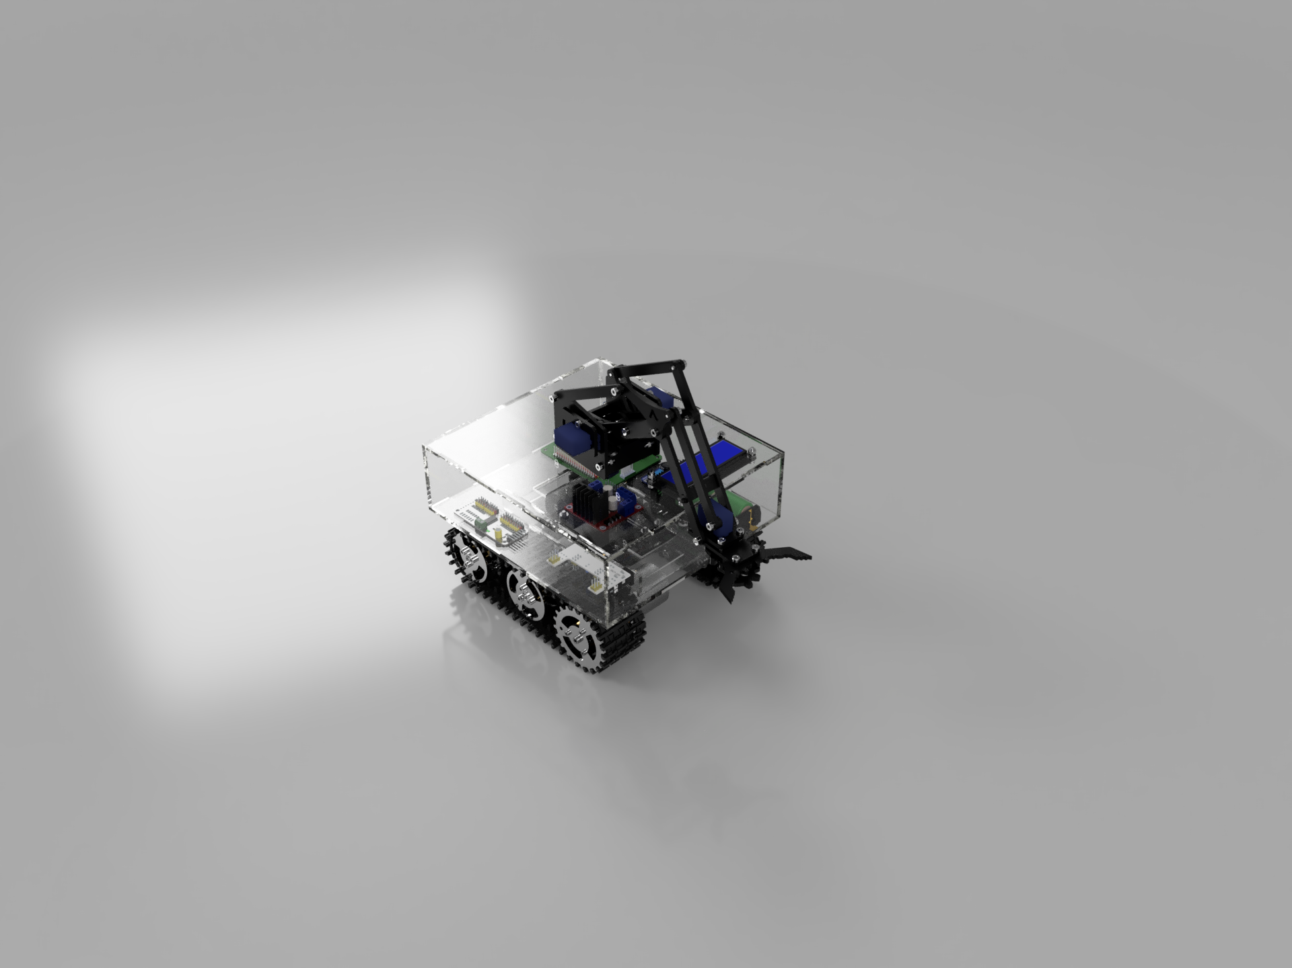
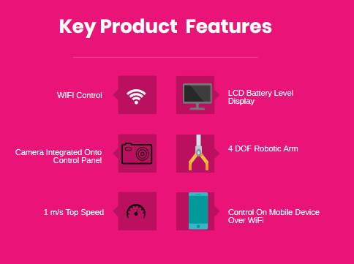
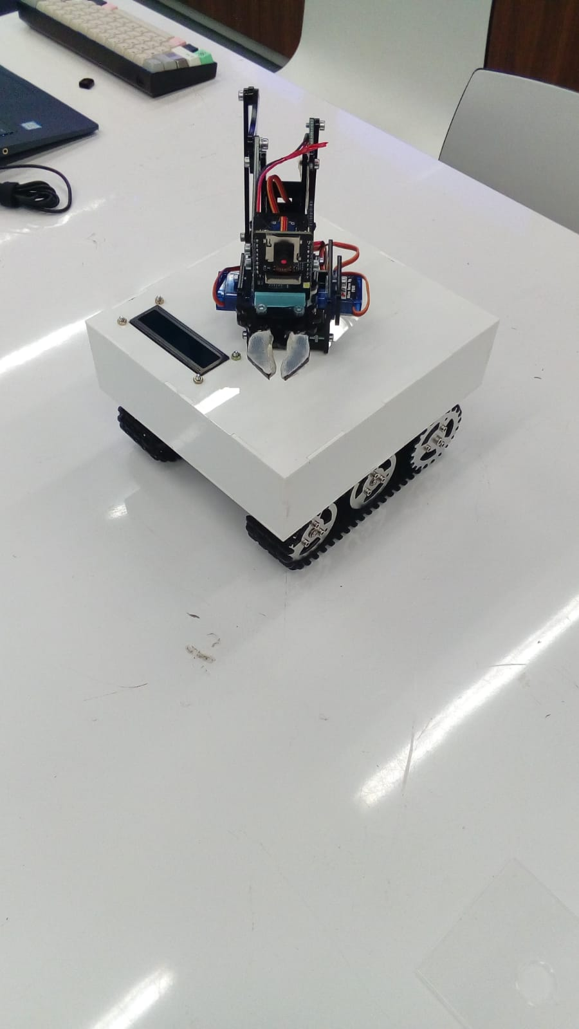
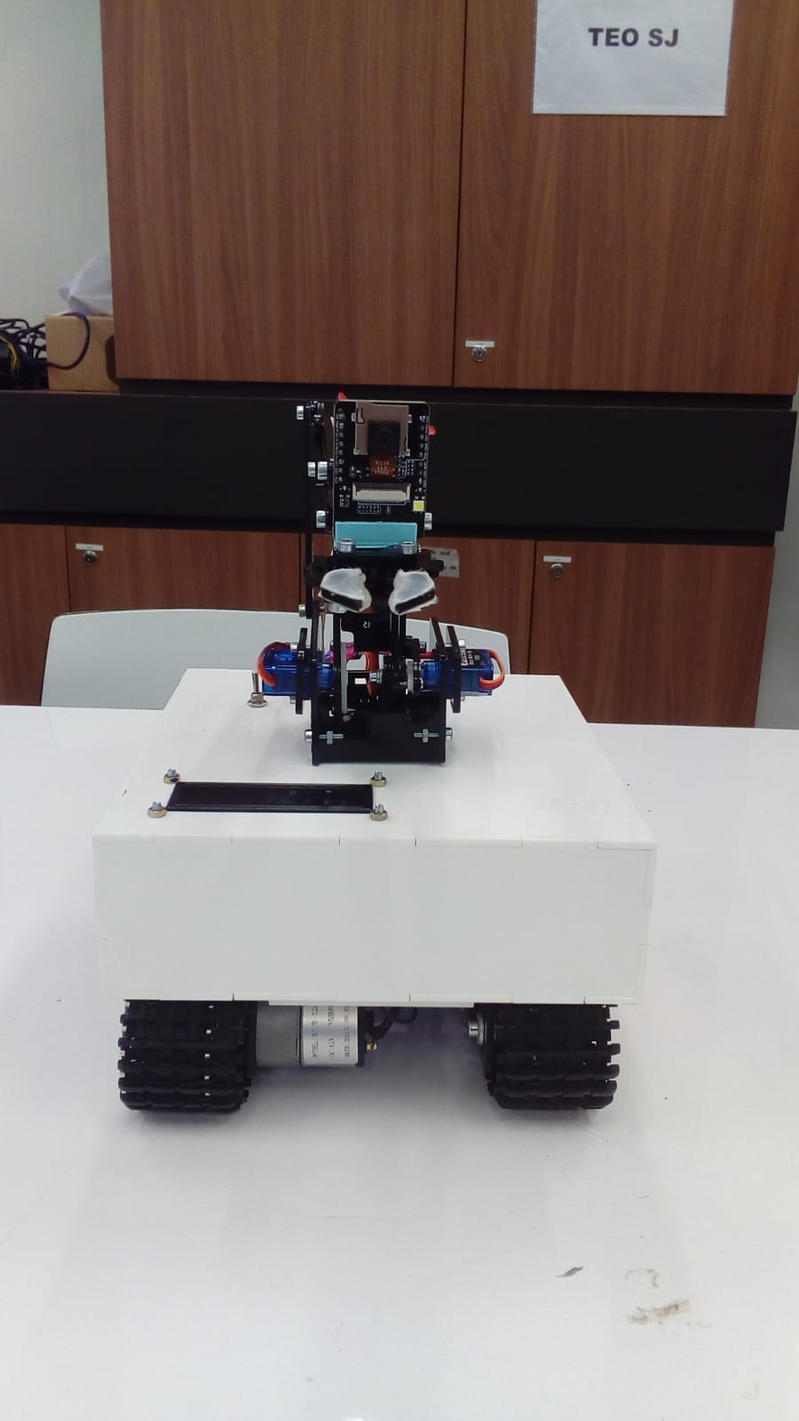
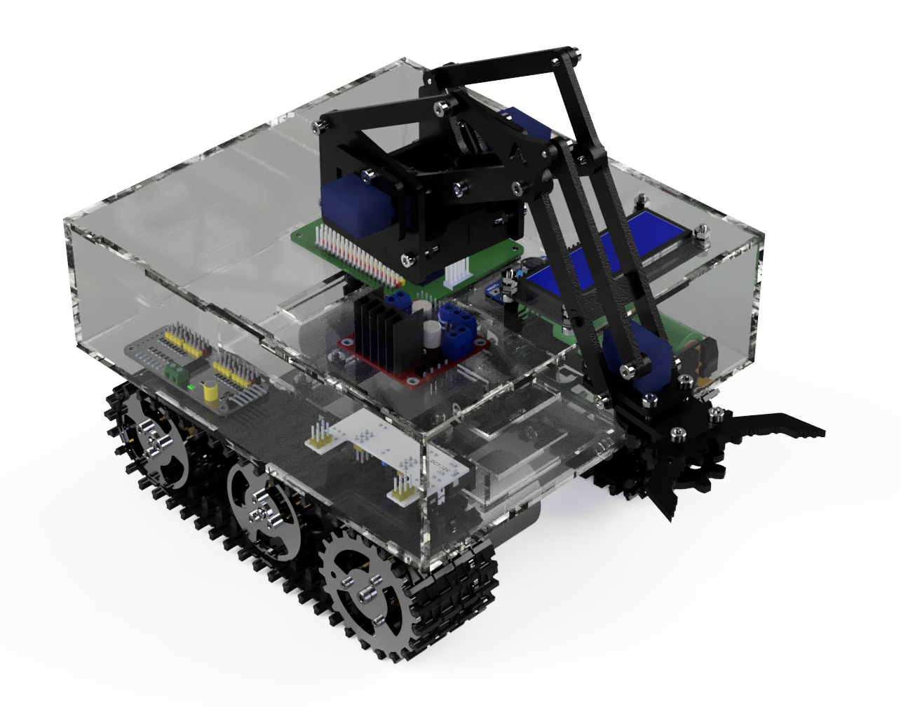
TEAM EXTINGUISHERS GEEKS
BOMB DISPOSAL TANK
Background
After war, there are many unexploded bombs or mines leftover that threaten civilian lives. So, we conceived a way for civilians to safely dispose of bombs with minimal training
Problem Statement
How are we able to assist with bomb disposal?
Product developed:
BOMB DISPOSAL ROBOT
MODULAR DESIGN
EASY TO FABRICATE, ASSEMBLE AND USE
Product images
FULLY ASSEMBLED CAD MODEL
Team Members
Ang Kiat Wan Sorenson
Aeronautical Engineering
Jia Nan
Computer Engineering
Syed Shahul Hameed
Energy Systems and Management
Yeo Ying Shen Reynard
Mechanical Engineering
Website: https://github.com/sorenson523/xtinguisher.github.io

